Slide 1

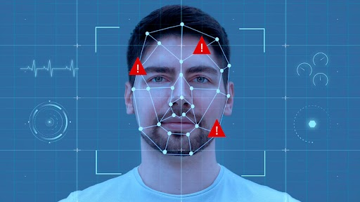
PANIMALAR ENGINEERING COLLEGE
(AN AUTONOMOUS INSTITUTION, AFFILIATED TO ANNA UNIVERSITY)
DEPARTMENT OF COMPUTER SCIENCE AND BUSINESS SYSTEMS
FAKETECT -DEEPFAKE DETECTION
DOMAIN- DEEP LEARNING
TEAM MEMBERS:
VIGNESH B [211420244120]
VINOTH P [211420244122]
YUGESH T [211420244124]
PROJECT GUIDE:
Mrs.R.JANANI.M.E.,
ASSISTANT PROFESSOR,
DEPARTMENT OF CSBS,
PANIMALAR ENGINEERING COLLEGE.
1
Notes:
1

Slide 2
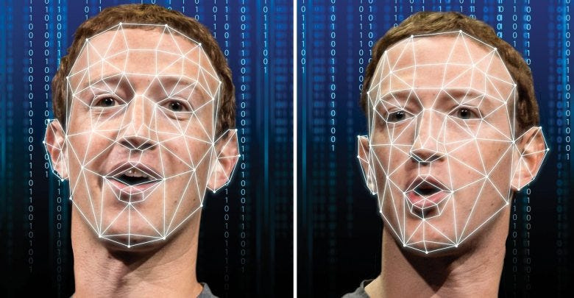
OVERVIEW
Objective
Abstract
Literature Survey
Existing System
Limitations of existing system
Proposed system
Advantages of proposed system
Architecture diagram
System requirements
Modules
Working module
Conclusion
Future enhancement
References

Slide 3
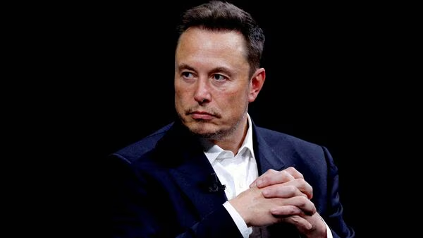
OBJECTIVES
Deepfakes can distort our perception of the truth and we need to develop a strategy to improve their detection. Deepfakes are increasingly detrimental to privacy, social security, and democracy.
Detection is crucial to combat the potential misuse of deepfakes, preventing the harm caused by false information, safeguarding privacy, and maintaining the trustworthiness of digital media.
We plan to achieve better accuracy for classifying real and fake videos
Example
A woman in South Korea was tricked into losing over $50,000 (Rs 41 lakh) following a scam involving Tesla CEO Elon Musk. According to the Independent, the woman identified as Jeong Ji-sun, believed she was interacting with billionaire Elon Musk on Instagram. In reality, it was just a deepfake video.
3

Slide 4
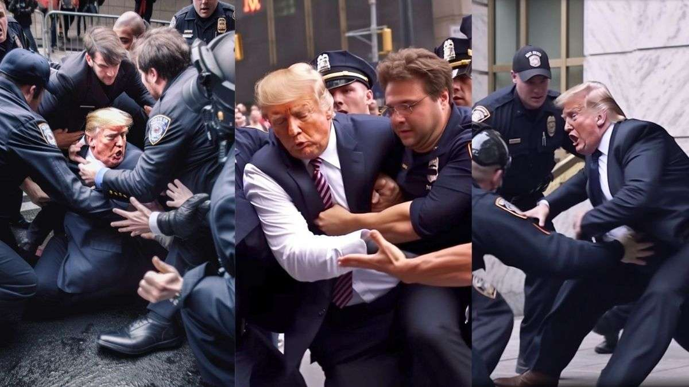

Many falsely showed the arrest of the former president, who may face indictment over payment of hush money to a woman he allegedly had an affair with. He has not yet been charged with a crime.
A short clip of what appears to be popular Indian star Rashmika Mandanna entering an elevator has blown up in India and received condemnation across the world. At first glance, the video looks to be a harmless clip of the 27-year-old Bollywood star – who has 39 million Instagram followers – in activewear getting out of the lift. But despite looking painfully realistic, the video isn’t Mandanna at all. The woman in the video was actually a British-Indian influencer named Zara Patel, with her real face being visible in the first frame of the six-second video.

Slide 5
ABSTRACT
The proliferation of deep fake videos in online platforms has raised significant concerns regarding the authenticity and trustworthiness of visual media content.
In response to this challenge, we present a robust DeepFake Detection System that leverages state-of-the-art deep learning techniques, namely ResNext and Long Short-Term Memory (LSTM), for effective video analysis with a user-friendly frontend built on ReactJs and a scalable backend powered by Flask.
2

Slide 6
EXISTING SYSTEM
In response to the proliferation of deepfake content, Facebook developed the Deepfake Detection Challenge (DFDC) system.
The DFDC system leverages advanced deep learning models, including convolutional neural networks (CNNs) and recurrent neural networks (RNNs), to analyze and detect deepfake videos.
4

Slide 7
LIMITATIONS
Longer processing times due to the intensive deep learning algorithms.
Inaccurate results of detection.
Its not robust and also not accessible by everyone.
Limited scope.
Privacy concerns.
5

Slide 8
PROPOSED SYSTEM
The core of our system leverages advanced deep learning models, including ResNext for feature extraction and LSTM networks for temporal analysis, to accurately identify deepfake videos.
This technical prowess is complemented by a user-friendly interface developed with ReactJS, providing an intuitive platform for users to upload videos, monitor the detection process in real-time, and access detailed reports on content authenticity.
6

Slide 9
ADVANTAGES
Shorter Longer processing times.
Accurate results of detection.
It is robust and easily accessible by everyone.
wide range of scope.
Highly secure.
7

Slide 10
LITERATURE SURVEY
SNO | NAME OF PAPER | AUTHORS | YEAR | FINDINGS
1. | DeepFakes and Beyond: A Survey of Deep Learning- Based Image and Video Manipulation Detection | Yuezun Li, Xin Yang, Pu Sun, Honggang Qi, Siwei Lyu | 2020. | In this comprehensive survey, the authors meticulously delve into the intricate landscape of deep learning techniques deployed for identifying manipulated images and videos, particularly focusing on the notorious phenomenon of deepfakes, Encompassing a broad spectrum of methodologies ranging from conventional image forensics to cutting- edge deep learning algorithms.
8

Slide 11
LITERATURE SURVEY
SNO | NAME OF PAPER | AUTHORS | YEAR | FINDINGS
2. | Advancements in Deep Learning-Based Deepfake Detection: A Critical Review | A. Sharma,R. Gupta, K. Singh | 2021 | This criticalreview meticulously evaluatesrecent advancements in deep learning techniques for deepfake detection, offering a nuanced analysis of state-of-the-art models. By rigorously assessing the strengths and weaknesses of these models, the review sheds light on the intricacies of real-world deployment challenges
9

Slide 12
LITERATURE SURVEY
SNO | NAME OF PAPER | AUTHORS | YEAR | FINDINGS
3 | A Surveyon Deep LearningTechniques for VideoForgery Detection | Reena Dadhich, Arun Solanki | 2020 | This survey is a dedicated exploration into the realm of video forgery detection, with a particular emphasis on leveraging deep learning methodologies to discern manipulations such as deepfakes within video content. Through a systematic review of various deep learning approaches, the authors illuminate the nuances of different detection strategies, outlining their respective strengths and limitations.
10

Slide 13
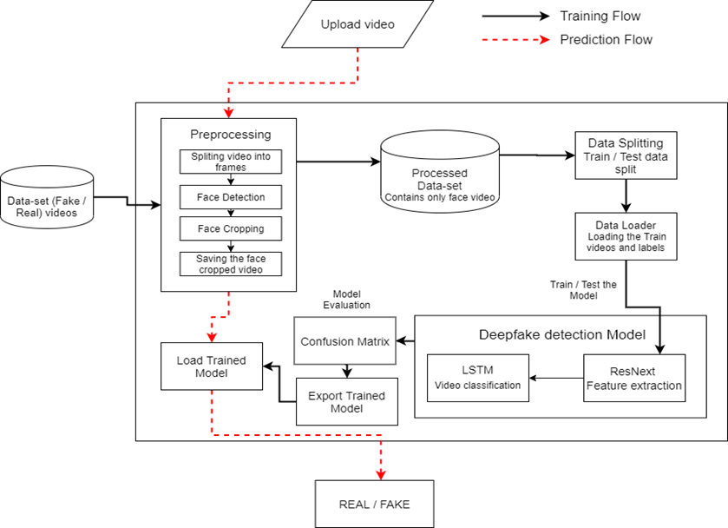
ARCHITECTURE DIAGRAM
11

Slide 14
SYSTEM SPECIFICATION
HARDWARE SPECIFICATIONS
Parameter | 9V 2A POWER SUPPLY
Intel Xeon E5 2637 | 3.5 GHz
RAM | 8 GB
Hard Disk | 100 GB
Graphic card | NVIDIA GeForce GTX Titan (8 GB RAM)
13

Slide 15
SOFTWARE SPECIFICATIONS
LANGUAGES | PYTHON ,HTML,CSS
FRAMEWORKS | REACT, FLASK
LIBRARIES | pytorch, face-recognition, opencv-python, scikit-learn, torchvision, Pillow, dlib, pandas, matplotlib, scipy etc
IDE | VSCODE, COLAB
14

Slide 16
LIST OF MODULES
Module 1 : Dataset Gathering
Module 2 : Pre-processing
Module 3: Data-set split
Module 4: Model Architecture
Module 5: Deployment

Slide 17
Module 1 : Dataset Gathering
For making the model efficient for real time prediction. We have gathered the data from different available data-sets like FaceForensic++(FF)[1], Deepfake detection challenge(DFDC)[2], and Celeb-DF[3].Further we have mixed the dataset the collected datasets and created our own new dataset, to accurate and real time detection on different kind of videos. To avoid the training bias of the model we haveconsidered 50% Real and 50% fake videos. Deep fake detection challenge (DFDC) dataset [3] consist of certain audioalerted video, as audio deepfake are out of scope for this paper. We preprocessedthe DFDC dataset and removed the audio altered videos from the dataset by runninga python script. After preprocessing of the DFDC dataset, we have taken 1500 Real and 1500 Fake videos from the DFDC dataset. 1000 Real and 1000 Fake videos from the FaceForensic++(FF)[1] dataset and 500 Real and 500 Fake videos from the CelebDF[3] dataset. Which makes our total dataset consisting 3000 Real, 3000 fake videos and 6000 videos in total. This diagram depicts the distribution of the data-sets.
15

Slide 18
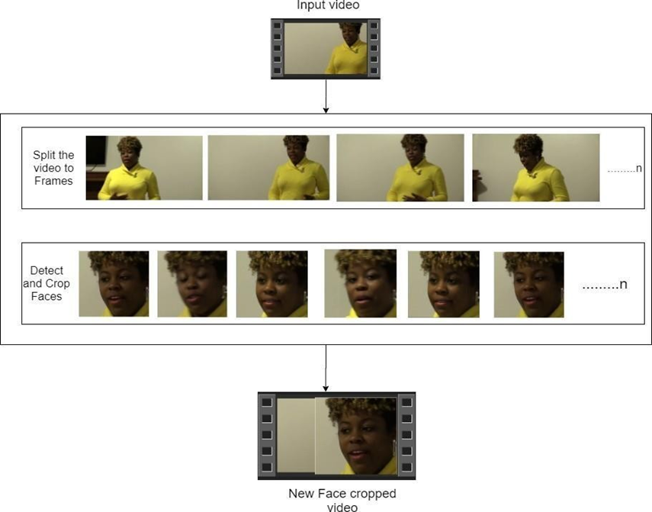
Module 2 : Pre-processing
In this preprocessing step, videos undergo noise removal and isolation of the face. Initially, the video is split into frames, with each frame scanned for facial detection and subsequently cropped. These cropped frames are then recompiled into a new video, creating a dataset of face-only videos. Frames without detected faces are disregarded. To ensure uniformity, a threshold value, derived from the mean frame count, is selected to limit computation. Given computational constraints, we set this threshold at 150 frames per video. The first 150 frames are preserved for each video to maintain consistency. Sequential processing is adopted to align with Long Short-Term Memory (LSTM) usage. The resulting videos are saved at a frame rate of 30 fps and resolution of 112 x 112.

Slide 19
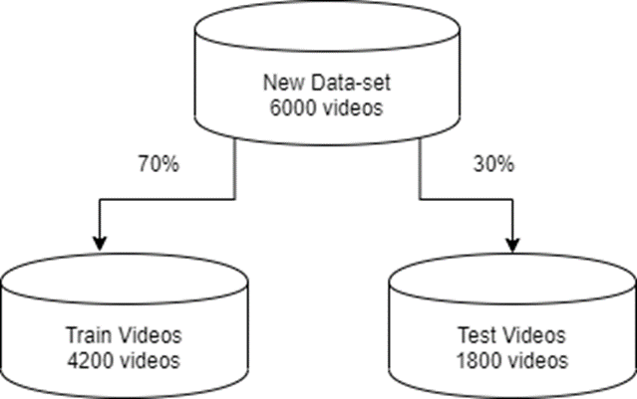
Module 3: Data-set split
Dataset splitting is a crucial step in machine learning and data analysis, where a given dataset is divided into multiple subsets for training, validation, and testing purposes.The dataset is split into train and test dataset with a ratio of 70% train videos (4,200) and 30% (1,800)test videos. The train and test split is a balanced split i.e 50% of the real and 50% of fake videos in each

Slide 20
Module 4: Model Architecture
Our model combines Convolutional Neural Networks (CNN) and Recurrent Neural Networks (RNN). We utilize a pre-trained ResNet CNN model, specifically the resnext50_32x4d model, for feature extraction. The ResNet architecture is optimized for deep neural networks, offering high performance. We fine-tune the ResNet by adding additional layers and adjusting learning rates for effective convergence.
The 2048-dimensional feature vectors extracted from the ResNet's last pooling layers serve as input for a Long Short-Term Memory (LSTM) network. We employ a single LSTM layer with 2048 latent dimensions and 2048 hidden layers, along with a dropout probability of 0.4, for sequence processing. The LSTM analyzes frames sequentially, comparing the current frame with past frames to assess temporal patterns.
To enhance the model's learning capabilities, we incorporate a Leaky ReLU activation function and a linear layer with 2048 input features and 2 output features. Additionally, we employ adaptive average pooling to ensure consistent output size. Sequential processing of frames is facilitated by a Sequential Layer, with a batch size of 4 for efficient training. Finally, a SoftMax layer provides confidence scores during prediction.

Slide 21
Module 5: Deployment
This module focuses on deploying the DeepFake Detection System into a user-friendly interface.
1. Design UI: Create an intuitive interface using HTML/CSS for layout and styling.
2. Integrate Backend: Use Flask to integrate the trained model for prediction.
3. Implement React Components**: Develop dynamic components for user interaction.
4. Handle File Uploads: Enable users to upload videos directly from their devices.
5. Display Results: Present detection results clearly to users.

Slide 22
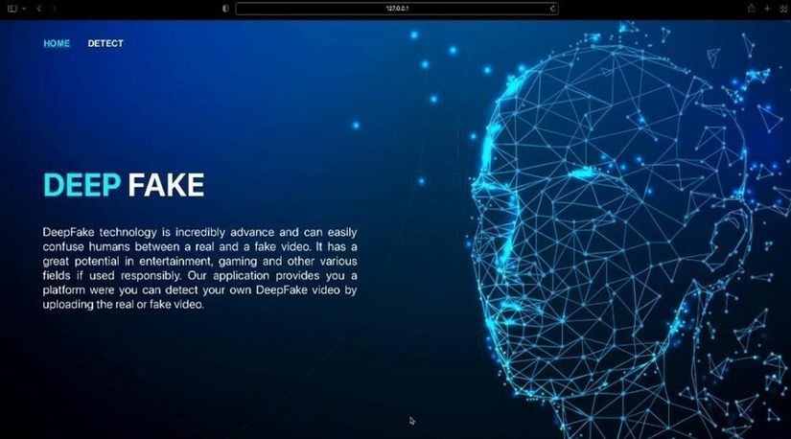
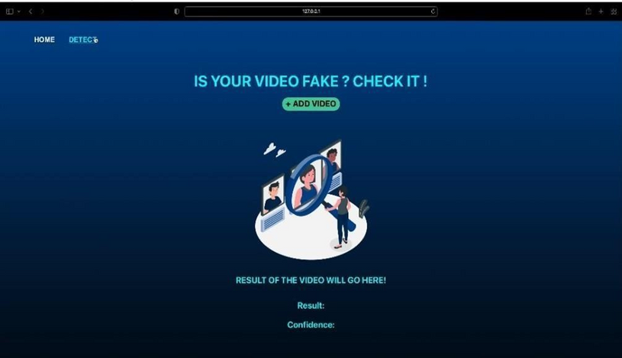
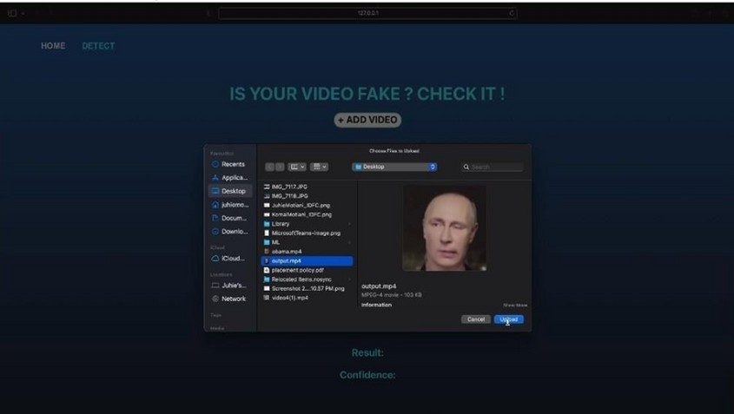
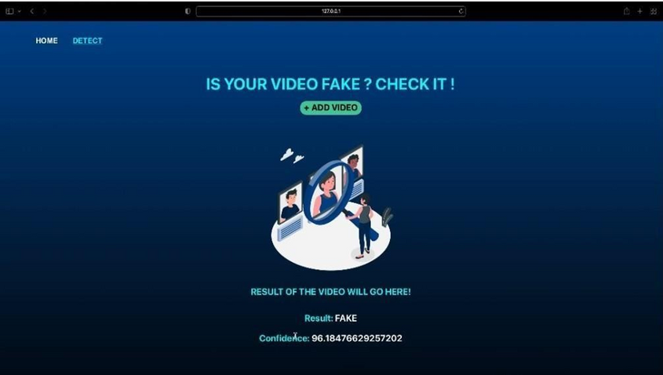
WORKING MODULE

Slide 23
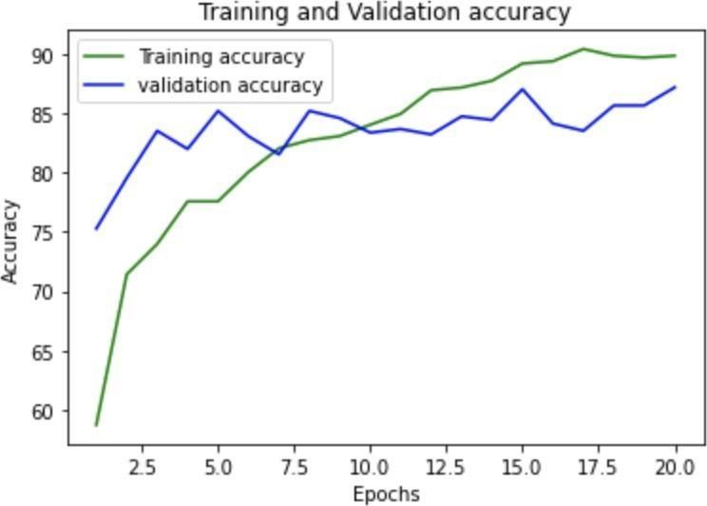
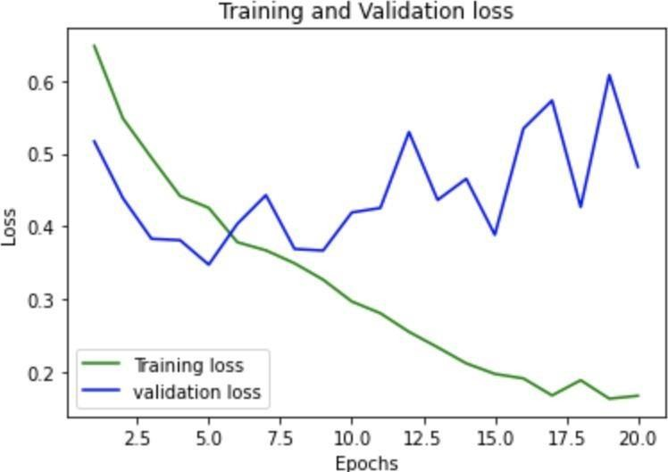
1. Accuracy of the Model:
2. Training and Validation accuracy:
3. Training and Validation Loss Graph::

Slide 24
CONCLUSION
In conclusion, our project has successfully addressed the challenge of detecting deepfake videos through the implementation of advanced deep learning techniques. We meticulously analyzedthe problem statement, ensuring the feasibility of our proposedsolution. By employing balanced training methodologies and rigorous evaluation techniques, we have developed robust deepfake detection models. The integration of our models into a user- friendly web-based application enhances accessibility, allowing users to easily verify the authenticity of videos. Furthermore, our comprehensive analysis of hardware and software requirements ensuresthe scalability and efficiency of our solution.
19

Slide 25
FUTURE WORK
Enhanced Accessibility: Hosting the system on a dedicated domain name would make it easily accessible to users, improving usability and reach.
Enhanced Model Performance: Continuously refiningand fine-tuning our deepfakedetection models can lead to improved accuracy and reliability.
Real-time Detection: Investigating methods to enable real-time deepfake detection, potentially through optimization techniques and leveraging parallel processing capabilities.
Dataset Expansion: Expanding our dataset to encompass a broader range of deepfakevariations and scenarios can further enhance the robustness and generalization of our models.
User Interface Enhancements: Iteratively improving the user interface of our web-based application to enhance usability and user experience, potentially incorporating additional features and functionalities.
20

Slide 26
REFERENCES
[1]Andreas Rossler, Davide Cozzolino, Luisa Verdoliva, Christian Riess, Justus Thies,Matthias Nießner, “FaceForensics++: Learning to Detect Manipulated Facial Images” in arXiv:1901.08971.
[2]Deepfake detection challenge dataset : https://www.kaggle.com/c/deepfake-detection- challenge/data Accessedon 26 March, 2020
[3]Yuezun Li , Xin Yang , Pu Sun , HonggangQi and Siwei Lyu “Celeb-DF: A Large-scale Challenging Dataset for DeepFakeForensics” in arXiv:1909.12962
[4]Deepfake Video of Mark Zuckerberg Goes Viral on Eve of House A.I. Hearing : https://fortune.com/2019/06/12/deepfake-mark-zuckerberg/ Accessed on 26 March, 2020
[5]10deepfake examples that terrified and amused the internet : https://www.creativebloq.com/features/deepfake-examples Accessed on 26 March, 2020
21

Slide 27
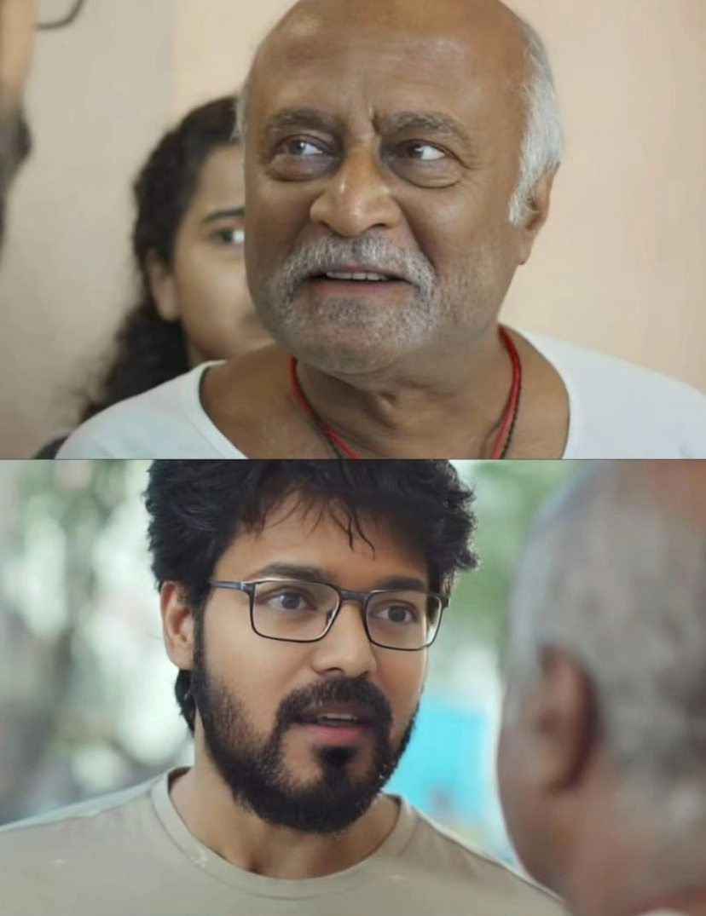
THANK YOU
22

